Slide 1


Slide 2
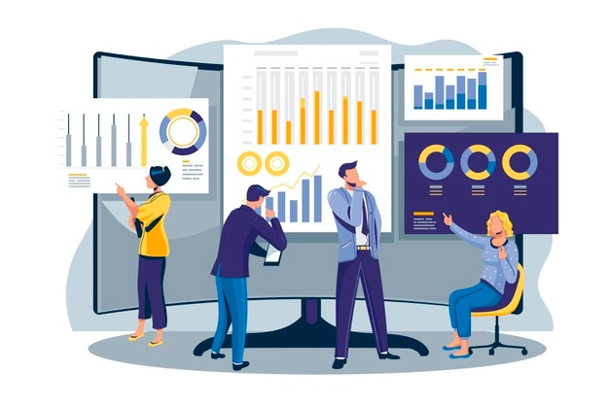
30 Days Python Master Class
Day1 : Python
Time: 6.00 PM IST
Free Registration

Slide 3
Python Master Class
Handbook

Slide 4
NANDHINI.S
Exp: 5 Yrs
Expert in
Python Developer on Machine Learning
Deep learning with computer vision
Matlab – Image Processing
Autonomous Car design using ROS with LIDAR
Language – Python , Java , HTML ,CSS.
Tools – ANACONDA NAVIGATOR, JUPYTER NOTEBOOK,
GOOGLE COLAB.
Graduation : BE – ECE | 2011

Slide 5
Pantech?
Educational Equipment Manufacturer
IoT, AI, Robotics,Autonomous Robot
Microprocessor/Microcontroller
DSP,VLSI, Embedded System
Power Electronics & Drives, Fuel Cell Trainer Kit
Renewable Energy Lab, Electric Vehicle Lab
Technical Training
DIY Project

Slide 6

What is Master Class ?
👍 This is the 30 Days Industrial Learning Activity.
👍 Its Online YouTube Live Class
👍 If you Invest 45 minutes daily, U will become Master in Data Science
👍 You will get FREE E-Certificate
Webinar Participation Certificate
“Learning is the beginning of wealth.
Searching & Learning is where the miracle process all begins.” …………….Jim Rohn

Slide 7
Our Vision
Help 10 Million Students to Learn the Technology in Easy Way

Slide 8

Associate Partner for this Master Class
https://apssdc.in/home/

Slide 9
What U will Learn from 30 Days Data Science & Analytics Master Class

Slide 10
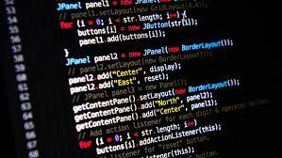
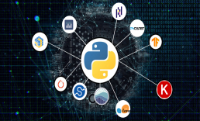



Python Learning Plan
01
02
03
04
05
Library
Python
Analytics
Analytics
Industry Project
Introduction To Python and Python Data Structures
Pandas
Numpy
MatplotLib
Cborn, SKLearn Lib
Collab
Distribution
Visualization
Aggregation
Statistics
Distribution Function
Project Building

Slide 11
Day wise Learning Plan
Day -1 : Introduction to Python
Day -2: Python – Tools|Syntaxes & Data Structures
Day -3: Python – Dictionaries,Date and Time
Day -4: Python – MySql
Day -5: Pandas library – Introduction
Day -6: Pandas library – Data Structures
Day -7: Numpy library – Introduction
Day -8: Numpy library – Array Manipulations, Mathematical Functions
Day -9: Matplotlib , Histogram Using Matplotlib | I/O With Numpy
Day -10: Matplotlib Library - Introduction , Pyplot API | Types Of Plots
Day -11: Seaborn Library
Day -12: SKLearn Library
Day -13: Python – Date and Time , Data Wrangling.
Day -14: Python – Data Cleansing
Day -15: Python – Word Tokenization , Stemming and Lammetization.

Slide 12
Day wise Learning Plan
Day -16: Python – Data Visualization
Day -17: Python – Statistical Analysis
Day -18: Python – Types Of Distribution
Day -19: Python – Correlation ,Chi-Square Test , Linear Regression
Day -20: Keras library – Introduction.
Day -21: Stock Price Prediction With Machine Learning LSTM RNN
Day -22: People’s behaviour in chat message using NLP NLP
Day -23: Gaming In Python
Day -24: Chatbot creation in Python NLP
Day -25: Electricity Price Prediction Using ML Random Forest Regressor
Day -26: Diamond Price Prediction Using Python Linear Regression
Day -27: Book Recommendation System KNN
Day -28: Image Classification Using CNN CNN
Day -29: Titanic Survival Analysis Using ML Logistic Regression
Day -30: Blockchain in Python

Slide 13
List of Projects for Demo in YouTube Live
Stock Price Prediction With Machine Learning
People’s behaviour in chat message using NLP
Gaming In Python
Chatbot creation in Python
Electricity Price Prediction Using ML
Diamond Price Prediction Using Python
Book Recommendation System
Image Classification Using CNN
Titanic Survival Analysis Using ML
Blockchain in Python
All Projects in Jupyter Notebook

Slide 14
What you will get from this Free 30 Days Master Class?
You can attend YouTube Live Class
Free E-Certificate ( WEBINAR PARTICIPATION CERTIFICATE)

Slide 15
How to mark your Attendance in YouTube Live Class?
Ans : During the Live Class, organizer will post Google Form link in Live Chat. The Participants should submit the from on daily basis. Minimum 25 Days Attendance is Required to get Free Master Class Participation Certificate.
Note : The Link will be available during the Live. From the LIVE Class date, the live video will get removed from the YouTube in 3 days.

Slide 16
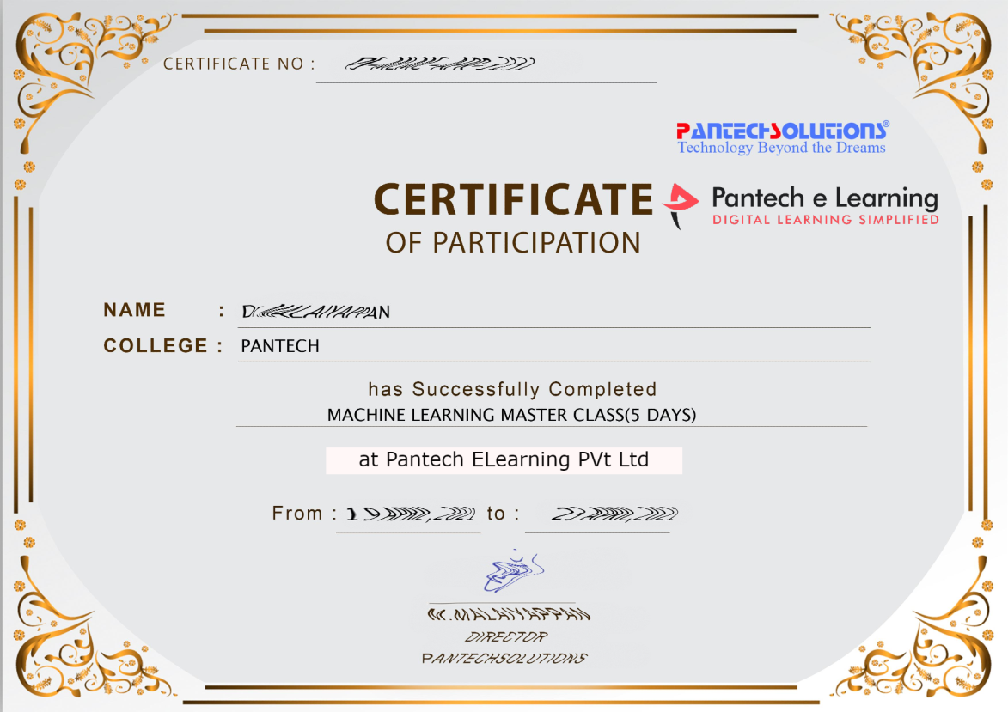

Sample Webinar Participation Certificate?

Slide 17
https://www.pantechelearning.com/data-science-master-class/
On Demand
You can get chance to apply 1 Month Internship on Data Science & Analytics Master Class

Slide 18
What is Internship????
Learn
Practice
Verify
Get Certified
Grow

Slide 19
Free Master Class DSA | 1 Month Internship on DSA
Master Class Participation Certificate | Internship Completion Certificate
Minimum 25 Class should attend YouTube Live | Recorded Class Link will be provided. – LMS Portal Access
YouTube Live Mandatory | Your Choice. You can attend Live or else You can watch Recorded Class in LMS Portal
All Projects Demo class in YouTube Live | Step by Step Video Explanation Content in LMS Portal
Access : 3 Days | VIP WhatsApp Group Support
 | You Can Download All PPTs
 | 4 Nos of Hackathon Class in Zoom Live. The Recording also will be provided
 | You Can Download All Project Files
 | Mentor will guide you to finish 10 Projects
 | Access : 60 Days

Slide 20
Pantech will make you to Create 10 Projects in Data Science & Analytics in 30 Days
Objective of this 30 Days Master Class

Slide 21
1 Month Internship in Data Science
INTERNSHIP E-Certificate(30Days Internship on Data Science Engineering)
Highly organized Video content
Download All Files
Download PPTs
Assignments
Flexible Time.
Access Period: 60Days from the date of payment

Slide 22
What You Will Get???
Complete Project Files
30 Days Learning Activity
Data Science Core Concepts
10 + Projects
Project PPT
Spatial Data Science For Covid-19 Disease Prediction
Parkinson’s Disease Prediction-XGBoost Classifier
House Price Prediction-Random Forest Regression
Customer Segmentation Using ML-K-Means Clustering
Home Loan Prediction-Decision Tree Classifier
Spam Classification-NLP
Hand Written Digit Recognition Using Python-CNN
Churn Prediction-Deep Learning
Crop Yield Prediction
Ground water level prediction
Video Class Access for 2 Months
Get chance to Enroll 1-Month Internship on demand

Slide 23
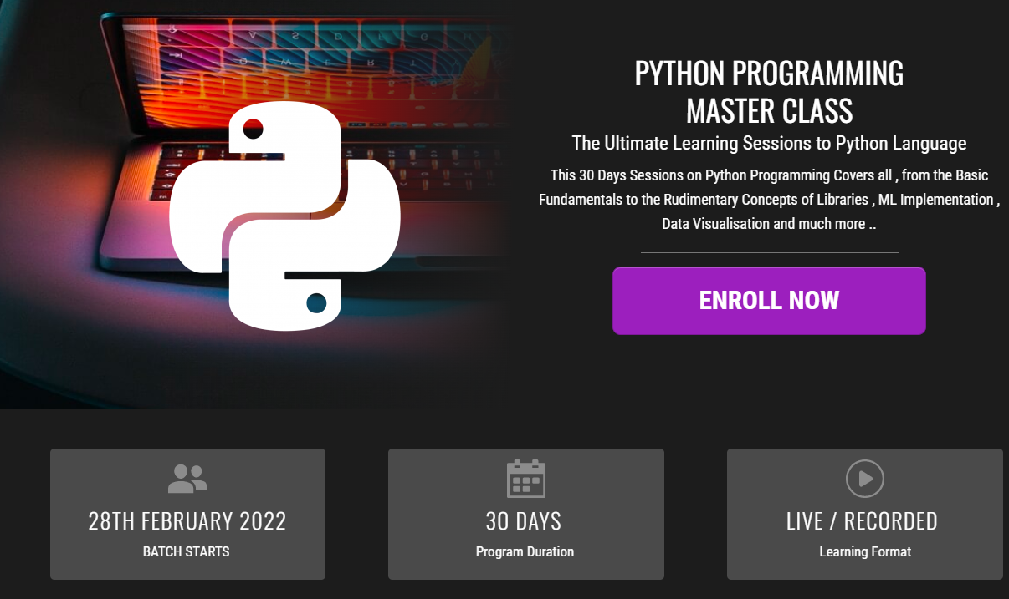
How to join in 1 month Internship
https://www.pantechelearning.com/pymc-internship/
Coupon Code: PYMC

Slide 24
Topic Modelling With LDA And NMF

Slide 25
Topic Modelling - Introduction
It is an unsupervised Machine Learning approach to clustering documents .
It is used to discover topics based on their contents.
It is very similar to K-Means Algorithm and Expectation – Maximization work.
We are clustering documents and we will have to process individual words in each document to discover topics and assign values to each based on the distribution of these words.
This increases the amount of data we are working with .
To handle large amount of processing required for clustering documents , we will have to utilize efficient sparse data structures.
Two different approaches are used for data modelling.

Slide 26
Topic Modelling - Introduction
These approaches are LDA(Latent Derilicht Analysis) and NMF(Non – Negative Matrix Factorization).

Slide 27
LDA(Latent Derelicht Analysis)
It is a probabilistic model.
To obtain cluster assignments , it uses two probability values: P(word|topics) and P(topics|documents).
These values are calculated based on an initial random assignment , after which they are repeated for each word in each document , to decide their topic assignment.
In an iterative procedure , these probabilities are calculated multiple times , until the convergence of the algorithm.
Take a look at three small documents , that will have two prominent topics , food and pets.

Slide 28
Topic Distribution In Documents
Topic 1 is about food(Topic A) , Document 2 is about pets(Topic B) and Document 3 is evenly split between A and B, with one unclassified word fish.
Using the existing information , we will obtain the topic to which Fish in Document3 should be classified to.
Calculate what the probability is of the word appearning in different topics.
P( ‘Fish’ | topic A) = 0.75
P( ‘Fish’ | topic B) = 0.25

Slide 29
Topic Distribution In Documents
We need the probability of the topics in the documents with the word in it , which is going to be:
P( topic A | Document 3) = P( topic B | Document 3) = 0.5.
Because they are evenly split.
Weighing the conclusions from both the probabilities , we will assign the word ‘Fish’ in Document 3 to topic A.

Slide 30
Topic Distribution In Documents
The next step of the algorithm would be to repeat this step for all words in each document , and then repeat the entire classification multiple times.
With multiple iterations, we will obtain better and better topic classifications each time because we will have more updated information for each document.

Slide 31
NMF:
Non – Negative Matrix Factorization is a Linear-algeabric model , that factors high – dimensional vectors into a low – dimensional representation.
Similar to PCA , NMF takes advantage of the fact that the vectors are non-negative.
By factoring them into low dimensional form , NMF forces the coefficients to also be non-negative.
Given the original matrix A , we can obtain two matrices W and H , such that A = WH.
NMF has an inherent clustering property , such that W and H represent the following information about A.
A(Document-word matrix) – input that contains which words appear in which documents.

Slide 32
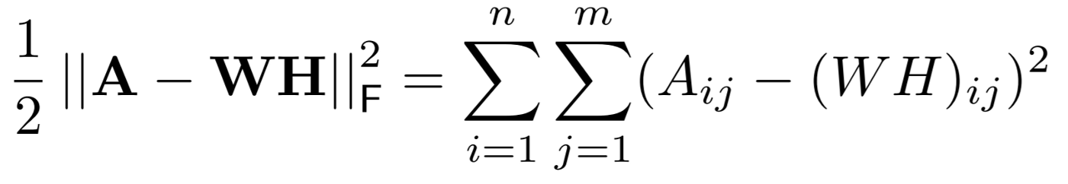
NMF
W(Basis Vectors): the topics(clusters) discovered from the documents.
H(Coefficient Matrix): the membership weights for the topics in each document.
W and H are calculated by optimizing over an objective function (like the EM algorithm) , updating both W and H iteratively over convergence.

Slide 33
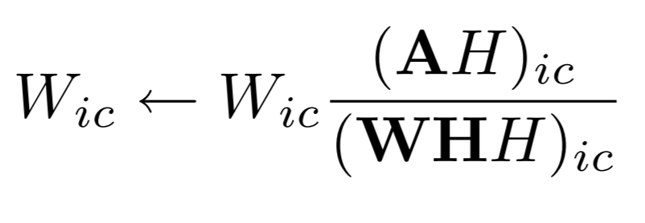
NMF
In this objective function , we measure the error of reconstruction between A and product of its factors W and H , based on Eucleidian distance.
Using the objective function , the update rules for W and H can be derived , and we get:

Slide 34
NMF
The updated values are calculated in parallel operations , and using the new W and H , we re-calculate the reconstruction error, repeating this process until convergence.

Slide 35
Code
Apply topic modelling on the ABC millions headlines dataset.
Imports:
The main libraries used in this project are Pandas and Numpy for their data structures , Scipy for sparse operations, Gensim(an open – source library that has different Topic Modelling modules) for LDA , and SKLearn(an open-source Machine Learning library) for NMF.

Slide 36
Code
import pandas as pd; import numpy as np; import scipy as sp; import sklearn; import sys; from nltk.corpus import stopwords; import nltk; from gensim.models import ldamodel import gensim.corpora; from sklearn.feature_extraction.text import CountVectorizer, TfidfTransformer; from sklearn.decomposition import NMF; from sklearn.preprocessing import normalize; import pickle;

Slide 37
Data Loading and Preprocessing:
ABC News headlines dataset is used.
data = pd.read_csv('data/abcnews-date-text.csv',
error_bad_lines=False);
# We only need the Headlines text column from the data
data_text = data[['headline_text']];

Slide 38
Data Loading and Preprocessing:
We need to remove stopwords first.
Casting all values to float will make it easier to iterate over because it will remove most of the edges:
data_text = data_text.astype('str');
for idx in range(len(data_text)):
#go through each word in each data_text row, remove stopwords, and set them on the index.
data_text.iloc[idx]['headline_text'] = [word for word in data_text.iloc[idx]['headline_text'].split(' ') if word not in stopwords.words()];
#print logs to monitor output
if idx % 1000 == 0:
sys.stdout.write('\rc = ' + str(idx) + ' / ' + str(len(data_text)));

Slide 39
Data Loading and Preprocessing:
#save data because it takes very long to remove stop words
pickle.dump(data_text, open('data_text.dat', 'wb'))
#get the words as an array for lda input
train_headlines = [value[0] for value in data_text.iloc[0:].values];

Slide 40
Implementing LDA:
Initialize the number of topics we need to cluster:
num_topics = 10;
Use the genism library for LDA.
Obtain a id-2-word dictionary.
For each headline , use the dictionary to obtain the mapping of a word id to their word counts.
The LDA model uses both of these mappings.

Slide 41
Implementing LDA:
id2word = gensim.corpora.Dictionary(train_headlines);
corpus = [id2word.doc2bow(text) for text in train_headlines];
lda = ldamodel.LdaModel(corpus=corpus, id2word=id2word, num_topics=num_topics);

Slide 42
Generating LDA Topics:
Iterate over the number of topics , get the top words in each cluster , add them to the DataFrame , then print these words.
def get_lda_topics(model, num_topics):
word_dict = {};
for i in range(num_topics):
words = model.show_topic(i, topn = 20);
word_dict['Topic # ' + '{:02d}'.format(i+1)] = [i[0] for i in words];
return pd.DataFrame(word_dict);

Slide 43
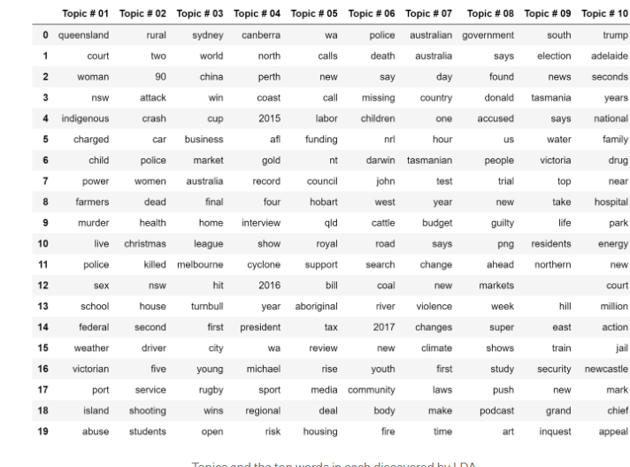
Generating LDA Topics:
Call the function and obtain the topics:
get_lda_topics(lda, num_topics)

Slide 44
Implementing NMF:
First , we need to obtain a design matrix.
To improve results , apply tfidf transformation to the counts.
#the count vectorizer module needs string inputs, not array, so I join
them with a space. This is a very quick operation.
train_headlines_sentences = [' '.join(text) for text in train_headlines]

Slide 45
Implementing NMF:
We obtain a Counts design matrix , for which we use SKLearn’s CountVectorizer module.
The transformation will obtain a matrix of size (Documents * Features) , where the value of a cell is going to be the number of times the feature(word) appears in that document.
To reduce the size of the matrix , to speed up computation , we will set the maximum feature size to 5000, which will take the top 5000 features that can contribute to our model.

Slide 46
Implementing NMF:
vectorizer = CountVectorizer(analyzer='word', max_features=5000);
x_counts = vectorizer.fit_transform(train_headlines_sentence
Set a Tfidf Transformer , and transform the counts with the model.
transformer = TfidfTransformer(smooth_idf=False);
x_tfidf = transformer.fit_transform(x_counts);

Slide 47
Implementing NMF:
Normalize the tfidf values to unit length for each row.
xtfidf_norm = normalize(x_tfidf, norm='l1', axis=1)

Slide 48
Implementing NMF:
Obtain a NMF model , and fit it with sentences.
#obtain a NMF model.
model = NMF(n_components=num_topics, init='nndsvd');
#fit the model
model.fit(xtfidf_norm)

Slide 49
Generating NMF Topics:
Iterate over each topic , obtain the most important scoring words in each cluster , and add them to a dataframe.

Slide 50
Generating NMF Topics:
def get_nmf_topics(model, n_top_words):
#the word ids obtained need to be reverse-mapped to the words so we can print the topic names.
feat_names = vectorizer.get_feature_names()
word_dict = {};
for i in range(num_topics):

Slide 51
Generating NMF Topics:
#for each topic, obtain the largest values, and add the words they map to into the dictionary.
words_ids = model.components_[i].argsort()[:-20 - 1:-1]
words = [feat_names[key] for key in words_ids]
word_dict['Topic # ' + '{:02d}'.format(i+1)] = words;
return pd.DataFrame(word_dict);

Slide 52
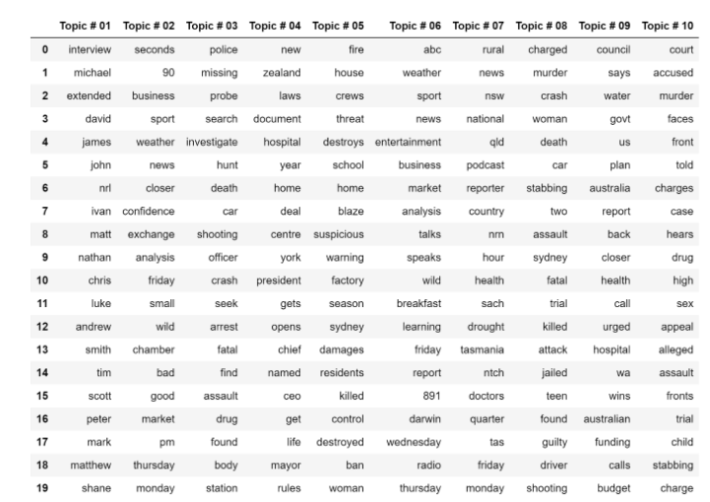
Generating NMF Topics:
Call the function and obtain the topics:
get_nmf_topics(model, 20)

Slide 53
Results:
The two tables , show the results from LDA and NMF on both datasets.
There is some coherence between the words in each clustering.
Topic #02 in LDA shows words associated with shootings and violent incidents , as evident with words such as “attack” ,”killed” , “shooting”, “crash” and “police”.
When comparing the results of LDA and NMF , NMF performs better.
When we look at Topic#01, we can see that there are many first names clustered into the same category.
Two topics are related to violence.
Topic #03 focusses on police related terms , such as “probe”,”missing”,”investigate” and “arrest”.

Slide 54
Results:
Topic #08 focusses on assault terms such as “murder”,”stabbing”,”guilty” and “killed”.
This is an interesting split between the topics because although the terms in each are very closely related , one focusses more on police – related activity and the other more on criminal activity.
Along with the first cluster which obtain the first names , the results show that NMF(using Tfidf)
Performs much better than LDA.

